Slide 1
Big Float Calculation
Computer Systems – Project1
19102077 Seok-jun Kang
21102044 Se-yeon OH

Slide 2



Table of Contents
Representing exceeding float number
Arithmetic operation
Limited point

Slide 3


The largest floating number

Slide 4
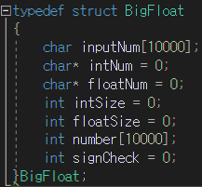
Representing exceeding float number
• Structure ‘BigFloat’
• input number -123.4567
• integer part (for storing) 123
• float part (for storing) 456
• length of integer part (for calculation) 3
• length of float part (for calculation) 4
• big number […, 1, 2, 3, 4, 5, 6, 7, …]
• sign (-) -> 1
‘storeNumber’
function to store and sort the number

Slide 5
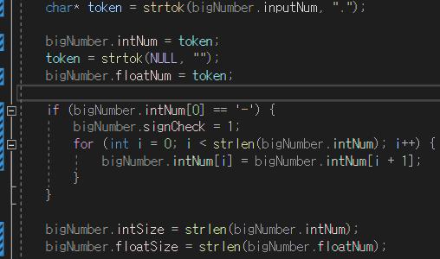
Representing exceeding float number
‘storeNumber’ function to store and sort the number
• inputNum <- input number (String) -123.4567
• integer part (String) ← 123
• float part (String) ← 456
• sign (Int) = 1 ← intNum[0] = ‘-’
• intSize = length of integer part (Int) ← 3
• floatSize = length of float part (Int) ← 4
big number (Int array) […, 1, 2, 3, 4, 5, 6, 7, …]

Slide 6
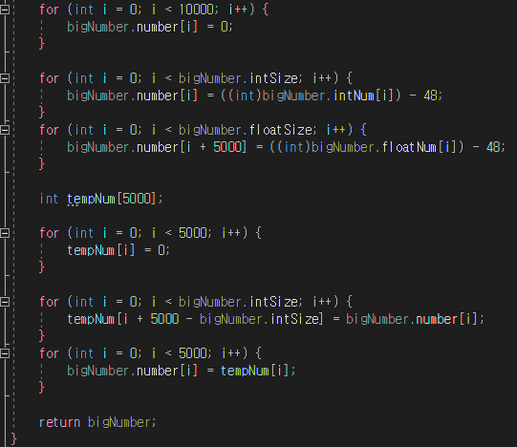
Representing exceeding float number
‘storeNumber’ function to store and sort the number
Store number in ‘bigNumber.number’
based on index[5000] = first float number
Fill in the front of Integer part by ‘intSize’ Fill in the back of decimal part by ‘floatSize’

Slide 7
Representing exceeding float number
< Storage structure >
Number [10000]
[ 0 ]
[ 1 ]
[ 2 ]
. . . .
[5000]
. . . .
INDEX :
[4999]
[9998]
[9999]
Integer part
Float part
Decimal point
Example) 123.123
0 | 0 | 0 | 0 | 1 | 2 | 3 | 1 | 2 | 3 | 0 | 0 | 0 | 0
Decimal point

Slide 8
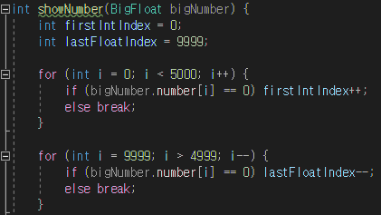
Representing exceeding float number
‘showNumber’ function to show the stored number
Don’t represent
empty array element

Slide 9
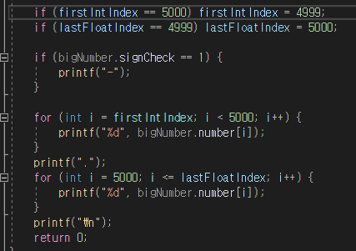
Representing exceeding float number
‘showNumber’ function to show the stored number
represent
sign, integer part, comma, and float part

Slide 10
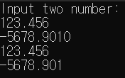
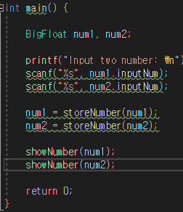
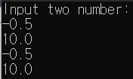
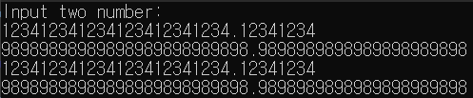
Representing exceeding float number
Main :
Input1 :
Input2 :
Ouput1:
Output2:
Input3 :
Input4 :
Output3:
Output4:

Slide 11
Representing exceeding float number
Input1 :
Input2 :
Ouput1:
Output2:

Slide 12
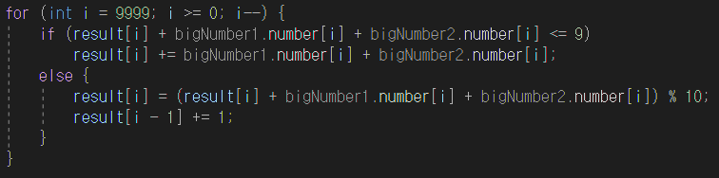
Arithmetic Operation - Addition
Adding direction
bigNumber1 :
 |  |  | 5 | 6 | 7 | 8 | 9
+
+
+
+
+
If addition result is over 10,
Add 1 to the value of result previous index
bigNumber2 :
 |  |  | 1 | 2 | 3 | 4 | 5
result:
 |  |  | 6 | 8 | 0 | 2 | 4
+1
+1
+1
Final result:
 |  |  | 6 | 9 | 1 | 3 | 4

Slide 13
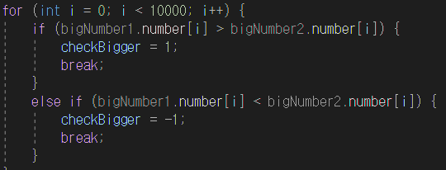
Arithmetic Operation - Addition
When adding numbers with different signs
1) Considering sign
2) Comparing absolute value
3) Using subtraction code
4) When the result is negative value, printing ‘-’ before printing result

Slide 14

Arithmetic Operation - Addition
Result :
123412341234123412341234.12341234
+ 98989898989898989898989898.9898989898989898989898

Slide 15
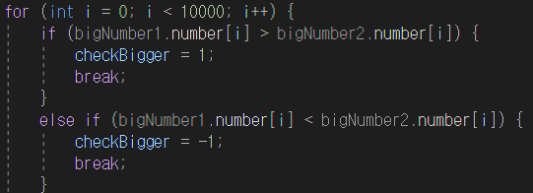
Arithmetic Operation - Subtraction
Comparing absolute value and defining big number
→ To subtract from big number to small number

Slide 16
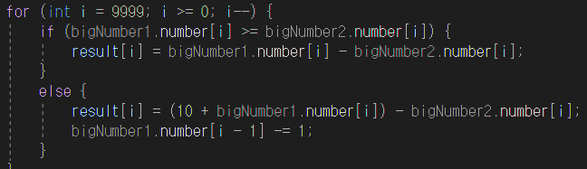
Arithmetic Operation - Subtraction
Subtraction direction
-1
-1
-1
Big Number :
 |  |  | 5 | 4 | 3 | 2 | 1
+10
+10
+10
‒
‒
‒
‒
‒
If (big number < small number)
Add 10 to the current big number
Subtract 1 to the value of result previous index.
Small Number :
 |  |  | 1 | 2 | 3 | 4 | 5
result:
 |  |  | 4 | 1 | 9 | 7 | 6

Slide 17
Arithmetic Operation - Subtraction
When subtract numbers with different signs
1) Considering sign
2) Comparing absolute value
3) Using addition code
4) When the result is negative value, printing ‘-’ before printing result

Slide 18

Arithmetic Operation - Subtraction
Result :
123412341234123412341234.12341234
- 98989898989898989898989898.9898989898989898989898

Slide 19
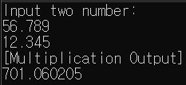

Arithmetic Operation - Multiplication
If result of each elements are over 10,
shares of dividing by 10 are added to previous index,
and the remainders stay in the index.
.
bigNumber1 :
 |  | 5 | 6 | 7 | 8 | 9
.
x
bigNumber2 :
 |  | 1 | 2 | 3 | 4 | 5
=
.
result:
 |  |  |  |  | 25 | 30 | 35 | 40 | 45
Loop this process……

Slide 20
Arithmetic Operation - Multiplication
If result of each elements are over 10,
shares of dividing by 10 are added to previous index,
and the remainders stay in the index.
.
bigNumber1 :
 |  | 5 | 6 | 7 | 8 | 9
x
.
bigNumber2 :
 |  | 1 | 2 | 3 | 4 | 5
=
.
result:
 |  |  |  | 20 | 49 | 58 | 67 | 76 | 45
Loop this process……
.
Final result:
 | 7 | 0 | 1 | 0 | 6 | 0 | 2 | 0 | 5

Slide 21
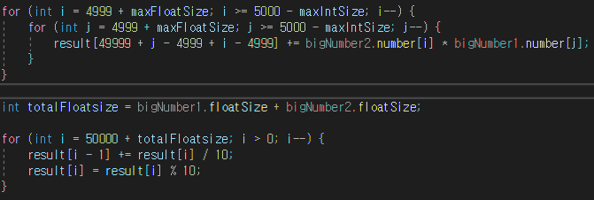
Arithmetic Operation - Multiplication
return as many as 100,000 digits.
Multiplication of each index
Making each number
less than or equal to 9

Slide 22
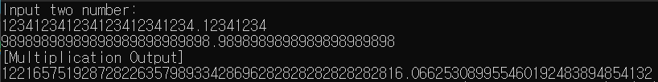
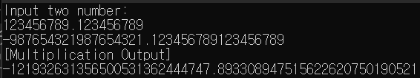
Arithmetic Operation - Multiplication

Slide 23
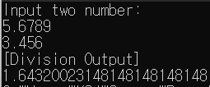

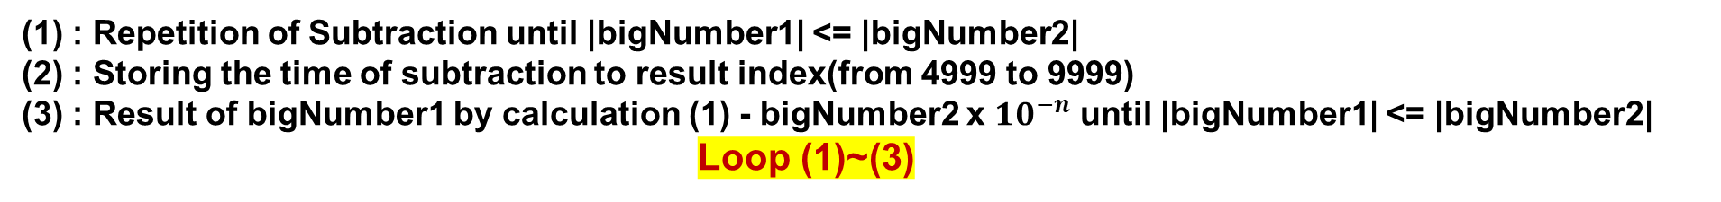
Arithmetic Operation - Division
: Repetition of Subtraction until |bigNumber1| <= |bigNumber2|
(2) : Storing the time of subtraction to result index(from 4999 to 9999)
(3) : Result of bigNumber1 by calculation (1) - bigNumber2 x ${10}^{−n}$ until |bigNumber1| <= |bigNumber2|
Loop (1)~(3)
.
5000
5001
5002
5003
5004
…
4997
4998
4999
bigNumber1 :
0 | 0 | 0 | 5 | 6 | 7 | 8 | 9 | 0
- Subtraction *1
.
bigNumber2 :
0 | 0 | 0 | 3 | 4 | 5 | 6 | 0 | 0
.
bigNumber1’ :
0 | 0 | 0 | 2 | 2 | 2 | 2 | 9 | 0
.
result:
0 | 0 | 0 | 1 | 0 | 0 | 0 | 0 | 0
Loop this process……

Slide 24
Arithmetic Operation - Division
: Repetition of Subtraction until |bigNumber1| <= |bigNumber2|
(2) : Storing the time of subtraction to result index(from 4999 to 9999)
(3) : Result of bigNumber1 by calculation (1) - bigNumber2 x ${10}^{−n}$ until |bigNumber1| <= |bigNumber2|
Loop (1)~(3)
.
5000
5001
5002
5003
5004
…
4997
4998
4999
bigNumber1’ :
0 | 0 | 0 | 2 | 2 | 2 | 2 | 9 | 0
- Subtraction *6
.
bigNumber2’ :
0 | 0 | 0 | 0 | 3 | 4 | 5 | 6 | 0
.
bigNumber1’’ :
0 | 0 | 0 | 0 | 1 | 9 | 6 | 3 | 0
.
result:
0 | 0 | 0 | 1 | 6 | 0 | 0 | 0 | 0
Loop this process……

Slide 25
Arithmetic Operation - Division
(2)
if (checkBigger == 1) {
for (int i = 4999 + maxFloatSize; i >= 5000 - maxIntSize; i--) {
if (bigNumber1.number[i] >= bigNumber2.number[i]) {
bigNumber1.number[i] = bigNumber1.number[i] - bigNumber2.number[i];
}
else {
bigNumber1.number[i] = (10 + bigNumber1.number[i]) - bigNumber2.number[i];
bigNumber1.number[i - 1] -= 1;
}
}
subNum++;
}
}
if (checkBigger == 0) {
subNum++;
result[resultIndex] = subNum;
break;
}
int tempNum2[10000];
for (int i = 0; i < 1000; i++) {
tempNum2[i] = 0;
}
for (int i = 0; i < 9999; i++) {
tempNum2[i + 1] = bigNumber2.number[i];
bigNumber2.number[i] = tempNum2[i];
}
maxFloatSize++;
result[resultIndex] = subNum;
resultIndex++;
subNum = 0;
}
return as many as 1,000 digits.
(1)
for (int i = 0; i < 499; i++) {
for (int i = 0; i < 10000; i++) {
if (bigNumber1.number[i] > bigNumber2.number[i]) {
checkBigger = 1;
break;
}
else if (bigNumber1.number[i] < bigNumber2.number[i]) {
checkBigger = -1;
break;
}
else checkBigger = 0;
}
while (checkBigger == 1) {
for (int i = 0; i < 10000; i++) {
if (bigNumber1.number[i] > bigNumber2.number[i]) {
checkBigger = 1;
break;
}
else if (bigNumber1.number[i] < bigNumber2.number[i]) {
checkBigger = -1;
break;
}
else checkBigger = 0;
}

Slide 26
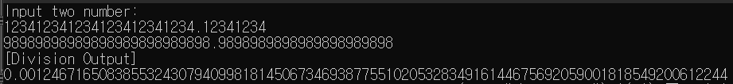
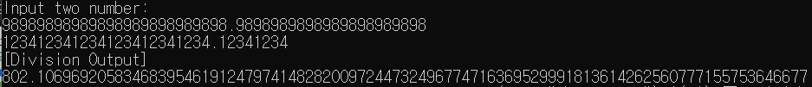
Arithmetic Operation - Division

Slide 27
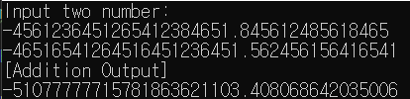
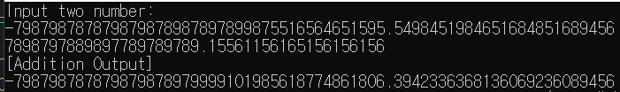
Random number - Addition

Slide 28
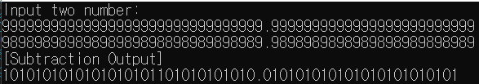
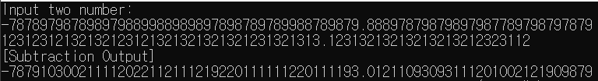
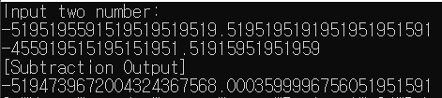
Random number - Subtraction

Slide 29
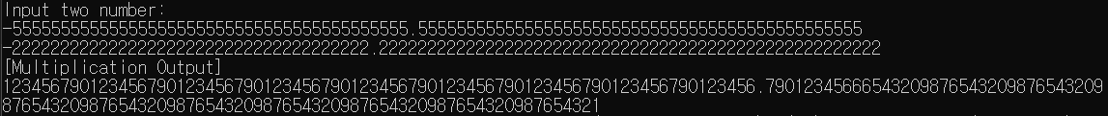
Random number - Multiplication

Slide 30
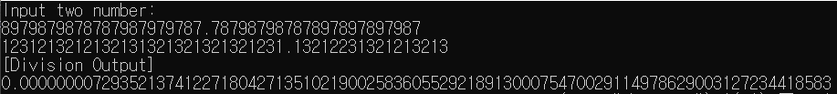

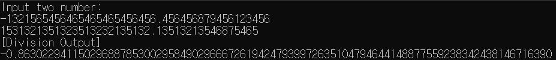
Random number - Division

Slide 31
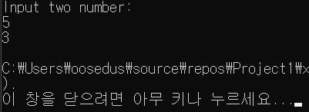
Limited Point
Can accommodate up to 10,000 digits
Difficulty in deriving result very large numbers divided by small numbers
Decimal points must be entered when entered

Slide 32
Thank you
19102077 Seok-jun Kang
21102044 Se-yeon OH

